Slide 1

Campus AI Intelligent Academic Management System
AI-Powered Academic Management System

Slide 2

Project Team
Jahnavi 23P31A4202
Niharika 23P31A4217
Yamini 23P31A4221
Vijay 23P31A4231
Karthik 23P31A4233
Neeraja 23P31A4265

Slide 3
Challenges in Academic Management
Manual and fragmented schedule management systems.
!
The Problem
Information scattered across notices and WhatsApp groups.
!
Fragmented communication leads to information gaps, causing students to miss opportunities and administrators to waste valuable time on manual updates.
Students miss critical updates like room changes or drives.
!
Administrators spend excessive time on repetitive queries.
!
Lack of a centralized intelligent communication system.
!

Slide 4
What is Campus AI?
AI-powered system built on Microsoft Power Platform.
•
Core Value
Provides instant access to schedules, placements, and faculty.
•
Campus AI provides a unified ecosystem where AI agents and automated workflows work in tandem to ensure that every student receives accurate, real-time academic information instantly.
Uses Claude AI and Power Automate for real-time responses.
•
Centralized cloud database (Dataverse) for accurate info.
•
Enhances student experience through intelligent chatbot interface.
•

Slide 5






Core Technologies
Power Apps
Power Automate
Copilot Studio
Frontend Interface
Workflow Automation
AI Agent Engine
Dataverse
Power BI
Azure AI
Cloud Database
Analytics & Dashboards
Cognitive Services

Slide 6
Three-Tier Architecture
PRESENTATION
LOGIC LAYER
DATA LAYER
Power Apps & Copilot Studio
Power Automate
Microsoft Dataverse
Provides the user interface for students and admins.
→
Processes natural language queries and updates.
→
Stores timetable, emergency updates, and placement info.
→
Hosts conversational AI agents for real-time interaction.
→
Handles backend operations and workflow logic.
→
Provides a secure and centralized cloud database.
→
Ensures a responsive experience across all devices.
→
Manages data flow between interface and database.
→
Ensures data integrity and real-time synchronization.
→

Slide 7
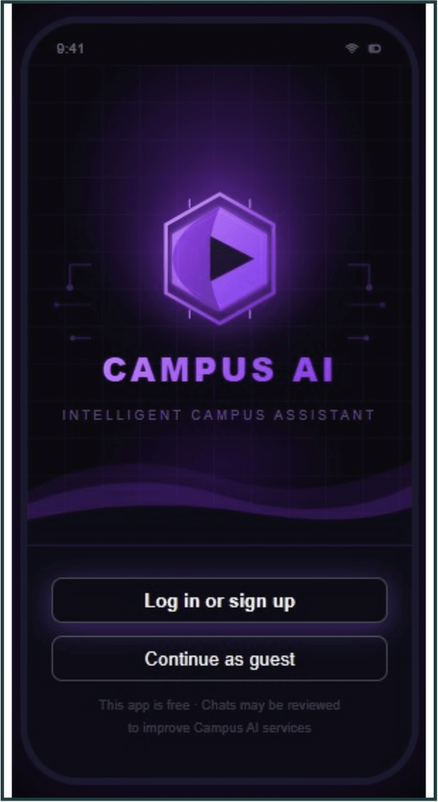
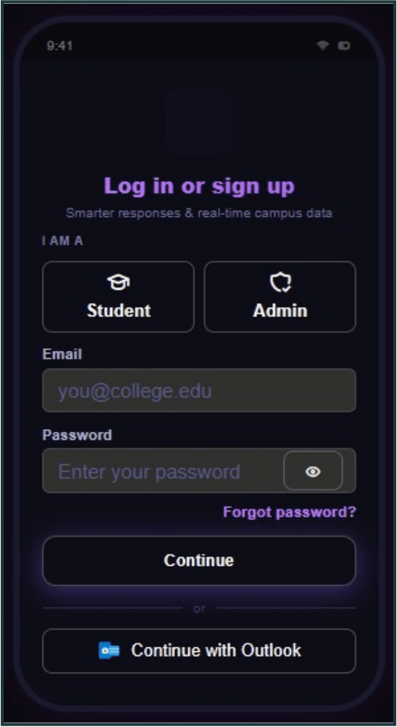
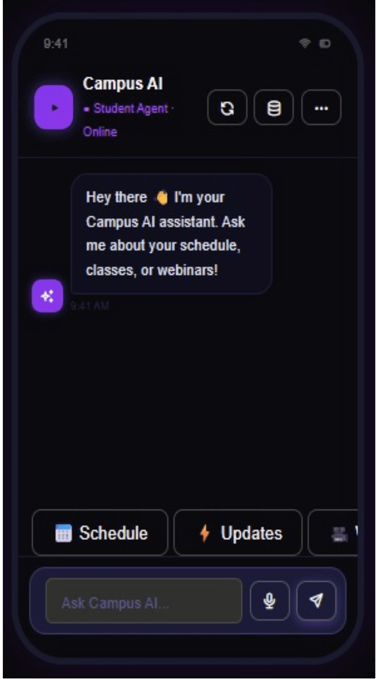
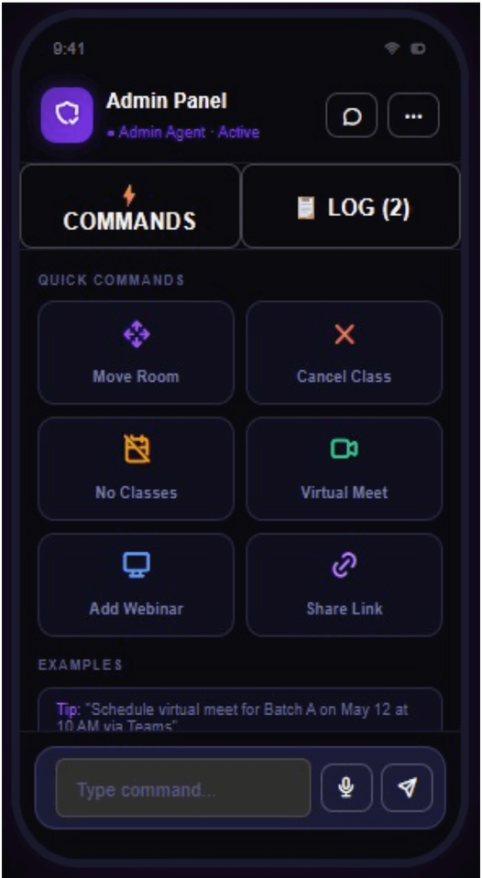
Interfaces Overview
Welcome Screen
Authentication
Student Agent
Admin Panel

Slide 8
Outcomes and Benefits
Centralized Communication: Eliminates fragmented updates.
✓
Key Impact
Real-Time Accuracy: Instant notifications on changes.
✓
Campus AI successfully bridges the gap between students and administrators, creating a more efficient, responsive, and intelligent academic environment using cutting-edge Microsoft technologies.
Reduced Admin Workload: Automates repetitive queries.
✓
Enhanced Experience: Modern AI-driven assistant.
✓
Scalable Solution: Built for future growth.
✓

